Slide 1
UFT Training
Presented by Lu, Chen-Zhi
Designed by Lu, Chen-Zhi

Slide 2
Self-introduction
Presenter
Lu, Chen-Zhi (卢晨之) Change
Qualification
About 9-year experience with Automation testing.
Automation consulter
Automation Framework

Slide 3
Agenda
Day 1 Fundamental-level :
UFT features
Repository
introduction of ALM
Day 2 Intermediate-level :
Automation framework
Parameters, Data, Action or function, Component
Web test—DOM
Advance features of UFT
AOM
OTA
Day 3 Advance-level:
Web Extensibility
Do Net Extensibility

Slide 4
How to learn UFT
Set a hard goal for yourself. (给自己设定一个高目标）
Practice （再简单，也要自己动手）
Blog (写博客)
Help to resolve the problem （帮同事解决问题）
Research and keep researching. （研究）
Take notes （做笔记，记录每个学习点）

Slide 5
Automation stuff
How UFT works
What is Automation
API (Application Programming Interface)
How UFT works
Web
.NET
Java
SAP
WPF
UFT Objects.
WebElement
WinObject
SwfObject
UFT Methods
UFT Help document

Slide 6
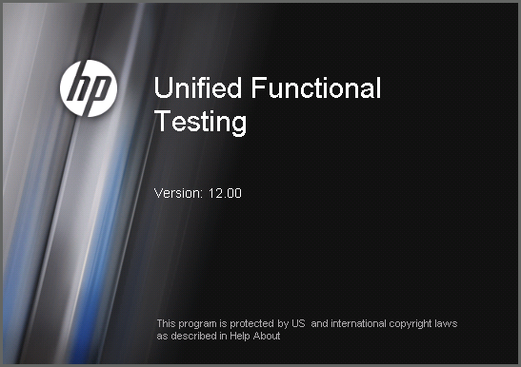
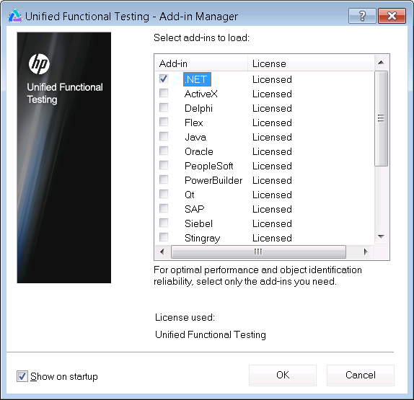
UFT IDE overview
UFT Add in window

Slide 7
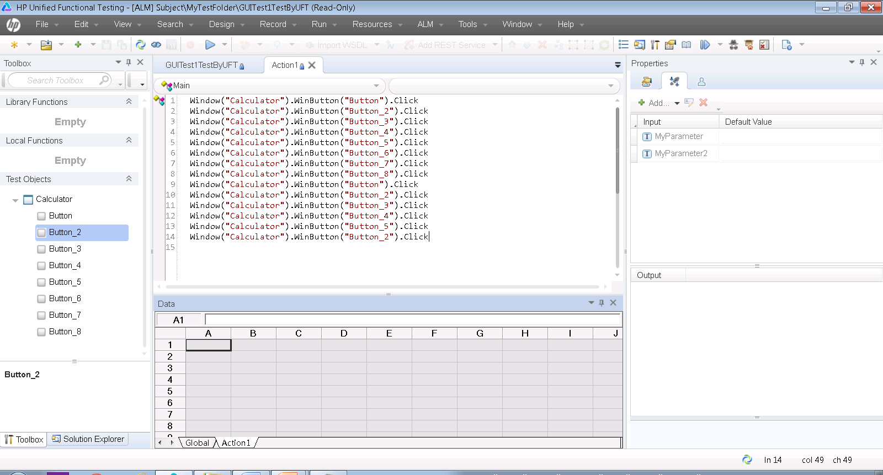
UFT IDE overview
UFT main window

Slide 8
UFT IDE overview
Demo
Demo: Record and replay

Slide 9
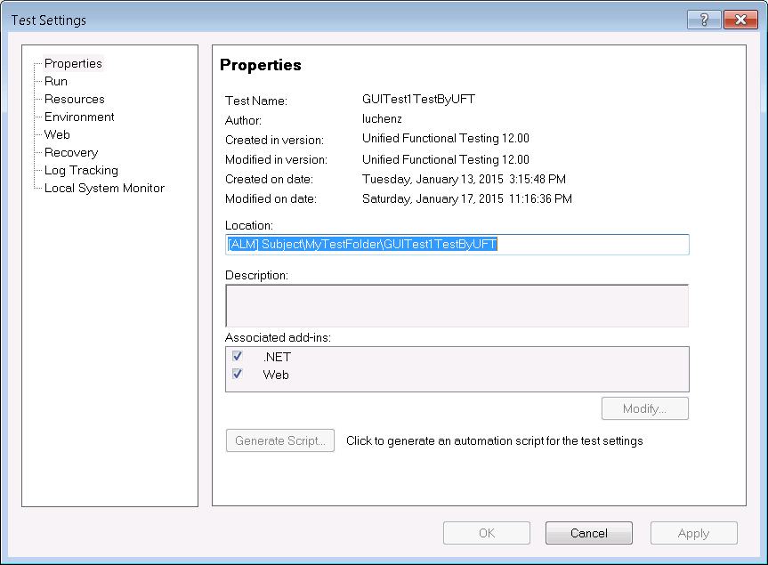
UFT IDE overview
Settings
File →Settings
Properties
Run
Resources
Parameters
…

Slide 10
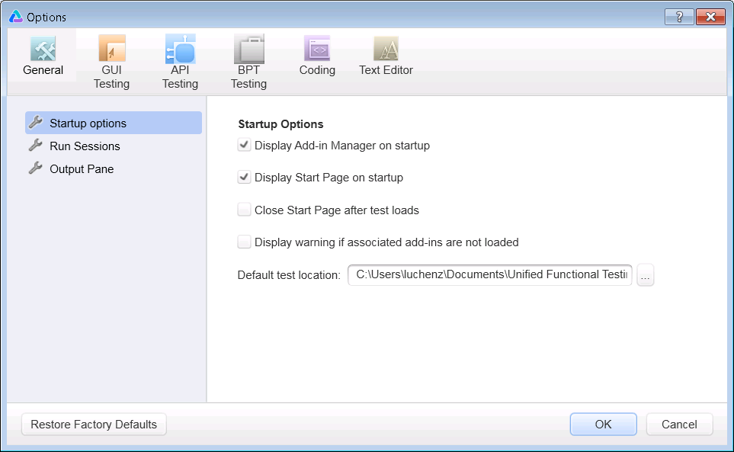
UFT IDE overview
Options
Tools →Options
General
GUI Testing
API Testing
BPT Testing
….

Slide 11
Working with UFT
Action
Data Table
Object Repository
Checkpoint
Output Value

Slide 12
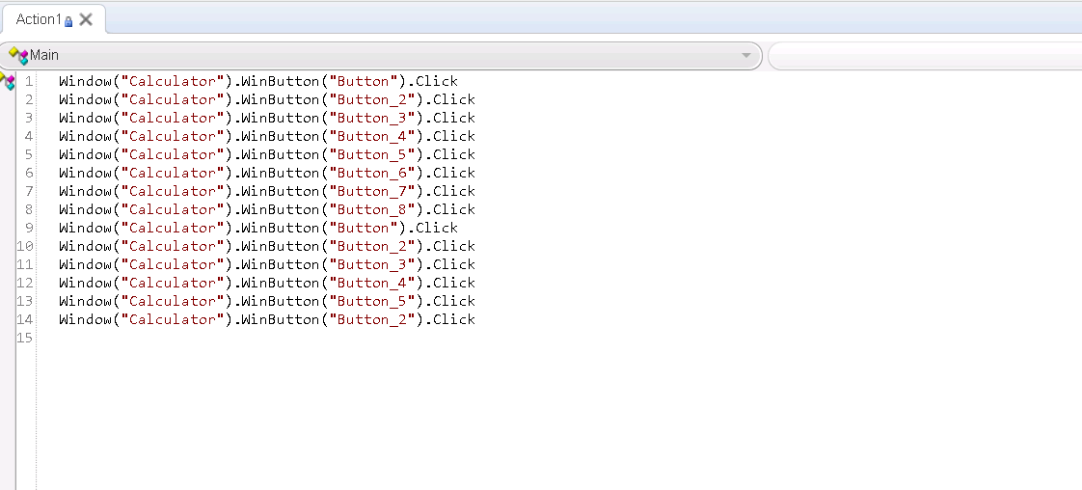
Action
Action Type
Action Operation

Slide 13
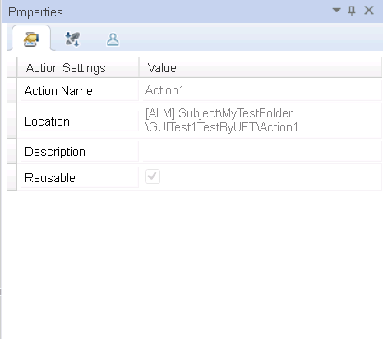
Action Type
View by Reusability
Reusable Action
Un-reusable Action
View by Location
Internal Action
External Action

Slide 14
Object Repository Type
Local Object Repository
Objects used only for Local Action
Shared Object Repository
Objects used for associated Actions
Notes:
We recommend Share OR rather Local OR in project.
It improves object reusability. It makes maintenance easy.

Slide 15
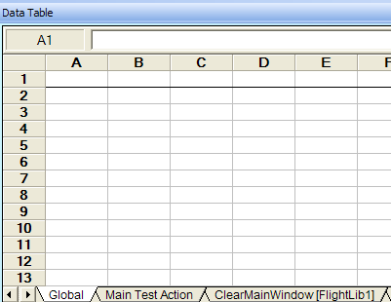
DataTable
Type
Local Sheet
Global Sheet
Property
RawValue
Value
Method
SetCurrentRow
GetCurrentRow
GetRowCount

Slide 16
Checkpoint
Where the expected data comes from?
Value of object’s property
Run-Time DataTable
Environment parameter
Note:
Checkpoint statement return a logical value (true or false).
Standard checkpoint/output steps can be added after recording, while text checkpoint/output steps can only be added during recording.

Slide 17
Output Value
Output Value Type
Standard output values
Text and text area output values
Table output values
Database output values
XML output values

Slide 18
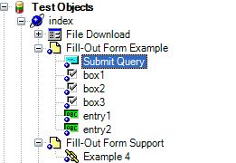
UFT Working Principle
Understanding How UFT Learns Objects
Understanding How UFT Identifies Objects During the Run Session

Slide 19
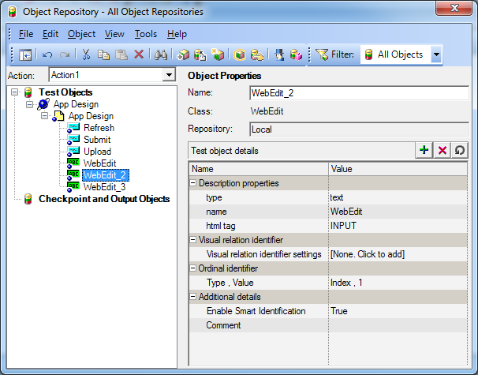
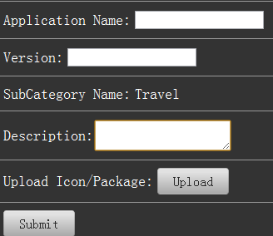
Understanding How UFT Learns Objects
Notes:
First, it "looks" at the object being learned and stores it as a test object, determining in which test object class it fits.
Then, QuickTest "considers" identification properties for the test object. For each test object class, QuickTest has a list of mandatory properties that it always learns;
If it is not, QuickTest adds assistive properties, one by one, to the description, until it has compiled a unique description;
If those available are not sufficient to create a unique description, QuickTest adds a special ordinal properties.

Slide 20
Understanding How UFT Identifies Objects During the Run Session
Notes:
During a run session, QuickTest searches for a run-time object that exactly matches the description of the test object it learned previously. It expects to find a perfect match for both the mandatory and any assistive(ordinal) properties it used to create a unique description while learning the object.
Even when the learned description is no longer accurate, with its Smart Identification mechanism to identify an object.

Slide 21
UFT Working Principle
How UFT works with the conditions in Repository
Description properties
Mandatory properties
Assistive properties
Visual Relation
Smart identification
Ordinal identifier

Slide 22
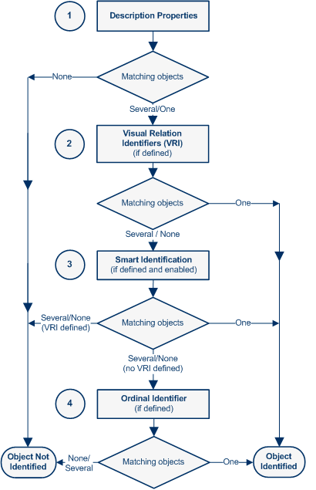
Object Identification flow
Notes:
If you defined Web object identifiers (such as XPath/CSS properties) for these test objects, they are used before the description properties. If one or more objects are found, QuickTest continues to identify the object using the description properties.
Additional QuickTest-generated properties, such as source index or automatic XPath, may also affect the object identification process.
Object Identification Process Workflow

Slide 23
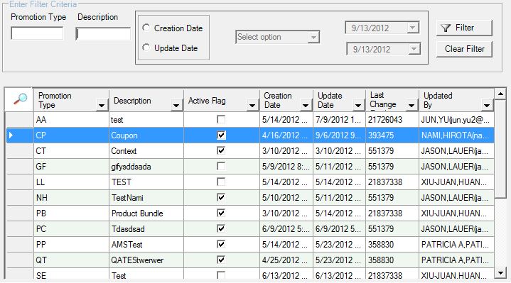
Check Point Practice
How to create a automation check point for this filter case?

Slide 24
Xpath

Slide 25
Q/A

Slide 26
Thank you

